Slide 1
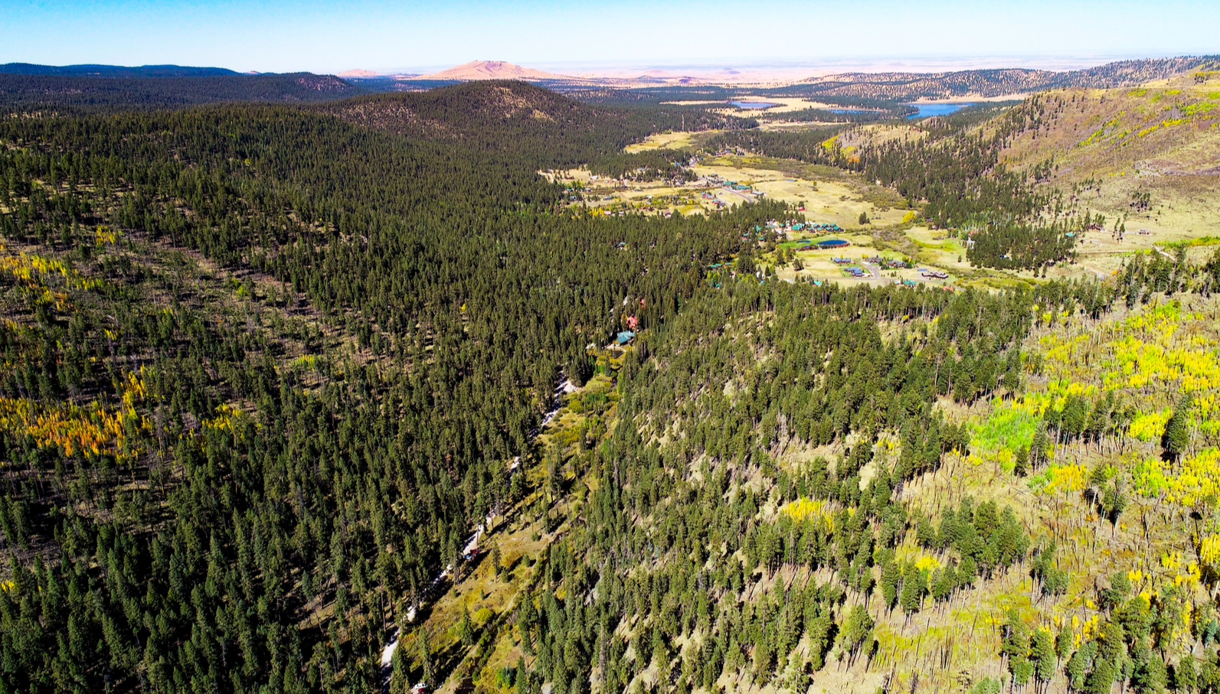
Greer Coalition
Annual Membership Meeting – 2026
A Sustainable Vision for Greer

Slide 2


Welcome
Notes:
We want to welcome all members and non-members.
Thank you all for taking your time out of you busy schedules.
Our purpose here is that by the end of today, you will understand the urgent issues and concerns facing Greer as we move forward.
Hope you will sense the urgency for growing the Coalition in numbers and added financial support.
That in some small way you can get involved with helping the Coalition strengthen its value as our community moves forward. It can’t be just the GCI Board if we want to succeed!!
Throughout this presentation, we encourage you to comment or ask questions as we go.

Slide 3
What is The Greer Coalition Inc. ?
A Coalition of citizens of Greer dedicated to keeping residents informed regarding the broad spectrum of land use issues impacting our community.
Our guiding light is a vision to preserve the character of Greer.
The GCI keeps track of activities in Greer in relation to existing ordinances.
Dedicated to informing and representing its members regarding impacts on land usage, and planning and zoning

Slide 4
Goals for Annual Meeting
  Introduce current board members
  Approve current board composition
  Review GCI goals and activities:
    - Article 6 and Condominium Development
    - Greer Firewise & Wildfire Mitigation Group
  Gain input from the membership
Notes:
Read items

Slide 5
2026 GCI Board Members
Fred Fiastro, President
Kate Darling: Secretary; Proprietor of “Mainstreet Cabins”
Richard Mosher: Treasurer
Stewart Smith: retired successful businessman with deep ties in Arizona
,

Slide 6
2025 GCI Board Members
Ken Western: Communications
Karen Steinbronn: Planning and Zoning
Patrick Lytle: 26 year resident; Land Use Interest

Slide 7
Board Election 2026
2 year Term
Fred Fiastro
Richard Mosher
Stewart Smith

Slide 8
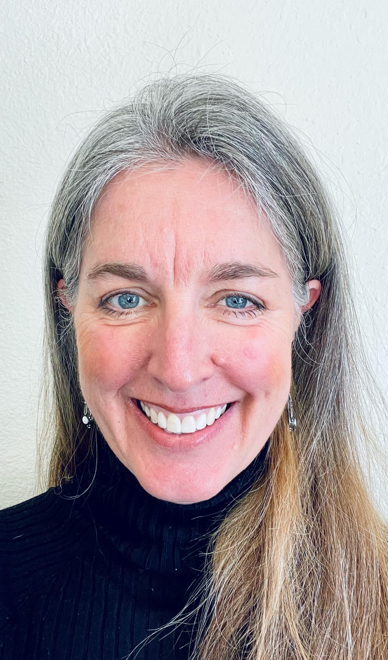
Kate Darling

Slide 9
2025 ANNUAL BUSINESS MEETING
Call Meeting to Order
Board Election: Voice vote

Slide 10
What Can you do To Help Our Efforts?
Given Recent History, It is more important than ever that you SUPPORT the Coalition.
MAKE A DONATION
Volunteer your time and resources
Participate in Community Activities
Members are the STRENGTH of the organization.
Numbers are the key to success.
Encourage Friends and Neighbors to join the GCI
Notes:
What can you do to get involved?

Slide 11
What Can you do To Help Our Efforts?
Support GCI with additional financial support
Join our effort TODAY by mail or through our website www.greercoalition.org!
Checks should be made to:
Greer Coalition Inc.
PO Box 265; Greer, Arizona 85927
Notes:
Your tax deductible contribution is vital to sustain GCI activities. The vast majority of GCI work is performed by our dedicated volunteers who have provided countless hours of work on behalf of the Greer Community. Monies are used by our board to pay postage, legal fees, insurance premiums and website maintenance.

Slide 12
Significant Activities of Past Year
Lead role in the Greer community monitoring compliance with the Greer zoning ordinance, Article 6.
Article 6 Amendment to require any private ownership/condominium activity to be within the Greer Commercial Resort zoning areas and to be part of an actual resort establishment.
We have been addressing the increasing fire risk in the White Mountains and Greer and the resulting impact on home insurance availability.

Slide 13
Greer Mountain Village proposal to rezone a 3.34ac residential property to accommodate 21 condominiums
Concerns
  Inappropriate Rezoning Processes
  Greer Commercial Resort (GCR) zone stated purpose in A6 is for hotel, other commercial guest accommodations.
  Interpretation of Article 6 allowance of free-standing condominium development within a Greer Commercial Resort (GCR) zone
  Potential for more widespread condominium development on more than 45 Greer properties with GCR zoning.

Slide 14
Article 6 Amendment
Resort: A hotel or motel that serves as a destination point for visitors. A resort generally provides recreational facilities for persons on vacation. A resort shall be self-contained and provide personal services customarily furnished at hotels, including the serving of meals.
The Greer Commercial Resort Zone is not intended to provide for residential Condominiums, Multifamily Dwellings, or Timeshares as defined in this Ordinance, ARS §33-1202 & ARS § 33-2202.

Slide 15
Greer Commercial Resort Zone Purpose
Greer Commercial Resort, high-density condominiums do not satisfy the intent of GCR zoning.
The purpose of such zoning is to provide for the development and operation of resorts, lodges, hotels, motels and bed and breakfasts. The purpose is not to provide exclusively for high-density condominium projects.

Slide 16
What does Greer Want?
2022 Survey of Residents regarding RVs and other issues under discussion in revising Article 6
Greater than 90% of respondents by email and FB ‘I Love Greer’ supported the concept that once Zoning rules are settled, County officials should enforce these rules unless there is great hardship demonstrated by the owner applicant.

Slide 17
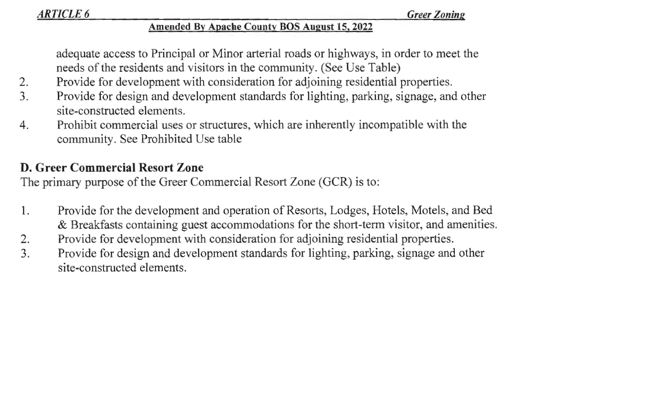
Article 6 GCR Purpose

Slide 18
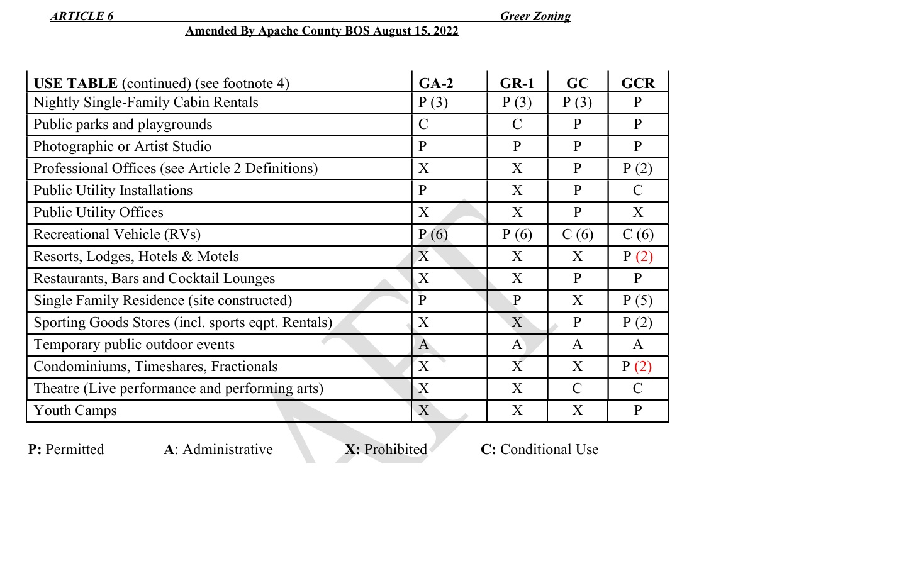
Article 6 Use Table

Slide 19
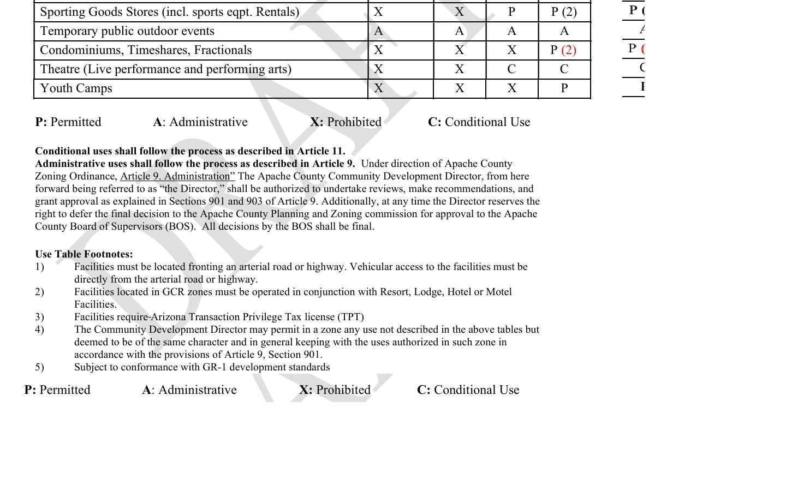
Article 6 Use Table
Footnote #2

Slide 20
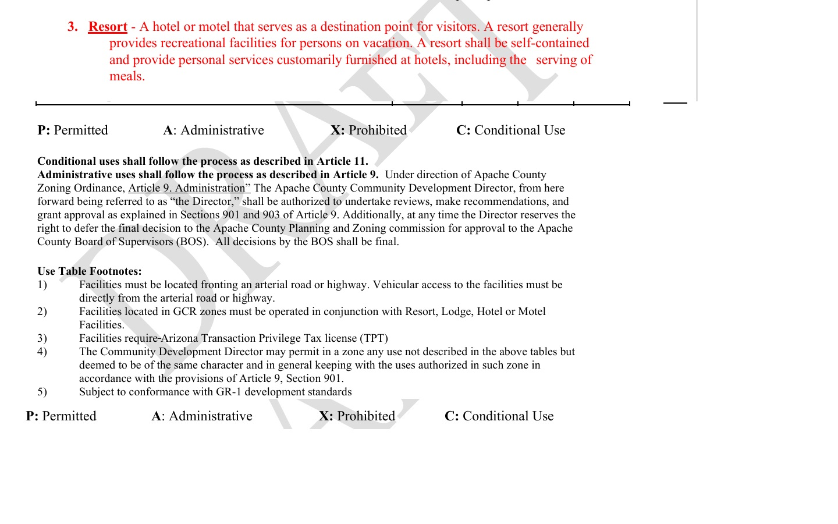
Article 6 Resort Definition

Slide 21
GCI Actions
Condo Proposal
Engaged legal experts to articulate community concerns
Gathered a group of interested Greer neighbors to assist in outreach to our fellow neighbors.
  Send Letters
  Sign Petition
  Raise Money to Pay Legal Expenses
  Attend August 17th Board of Supervisors meeting

Slide 22
Article 6 Amendment Petition
Over 200 signatures to date
Petitions available at our sign-in desk

Slide 23
GCI Actions
Condo Proposal
Amend Article 6 to eliminate the condominium loophole from GCR.
Planning and Zoning Commission Hearing: June 3, 2026
Board of Supervisors Meeting; Monday, August 17th 8:30am

Slide 24
What Happenned at P & Z?
Condominium Amendment
AMENDMENTS TO ARTICLE 6 OF THE GREER ZONING ORDINANCE
MOTION: Commissioner Bobby Fite moved to recommend that Article 6 remain unchanged and that the proposed amendments not be adopted. The motion was seconded by Commissioner Carey Dobson.
VOTE: 6 ayes to 0 nays. Unanimous.

Slide 25
Article 24; Short Term Rentals
Proposal to Repeal
This ordinance was designed to place limits on Short Term Rentals (STRs) within communities
Some elements of this ordinance were disallowed by State Statute adopted under Gov. Ducey.
However a number of elements designed to protect neighborhoods were allowed under state law.
Gila and Coconino Counties have adopted common sense ordinances requiring business licenses, county reporting of these activities and a 24hr contact for any neighborhood disturbance.
MOTION: Commissioner Brad Jarvis moved to recommended to the Board of Supervisors to repeal Article 24 of the Apache County Zoning Ordinance and to consider future revisions if warranted. The motion was seconded by Commissioner Bobby Fite. VOTE: 8 ayes, 0 nays. Motion carried unanimously.

Slide 26
Greer Fire Prevention and Mitigation Working Group
We have been addressing the increasing fire risk in the White Mountains and Greer and the resulting impact on home insurance availability.

Slide 27
Greer Fire Prevention and Mitigation Working Group
Fred Fiastro: property owner/moderator
Julie Boos; property owner/ Chair: Greer Firewise Board
Property owners:
Richard Mosher
Stewart Smith
Ramey Peru
Kimberly Owens
Bob Pollock
Bill Kurtz
Erica Cochran; Northwoods Neighborhood HOA
Carl Mare; Greer Lodge Estates HOA
Kevin Burns; Greer Mtn Estates HOA

Slide 28
Greer Fire Prevention and Mitigation Working Group
Greer Fire District:
Lee Smith: Fire District Board President
Rye Sluiter: Fire Chief
Frank Adams: Fire Captain
Gene Hechler; Fire District Auxiliary
Apache Sitgreaves National Forest:
Amanda Scott Matt Moe: Springerville District Ranger
Az State Forestry &Fire Management:
Jon Orona; District Forester
Josh Hudson; (Grants Program Manager)
Capt. Christopher Reed ; (Fire Prevention and Mitigation Officer)
Alpine:
Linda Attarian

Slide 29
Greer Fire Prevention and Mitigation Working Group
Navopache Electric Coop:
  Chuck Moore; CEO
  Brian Brownlow; Operations Manager

Slide 30
FireWise Working Group
Board Members:
  Julie Boos
  Ericka Cochran
  George Douvas
  Fred Fiastro
  Bill Kurtz
  Richard Mosher
  Lee Smith
  Kimberly Owens
  Paula Rupnik

Slide 31
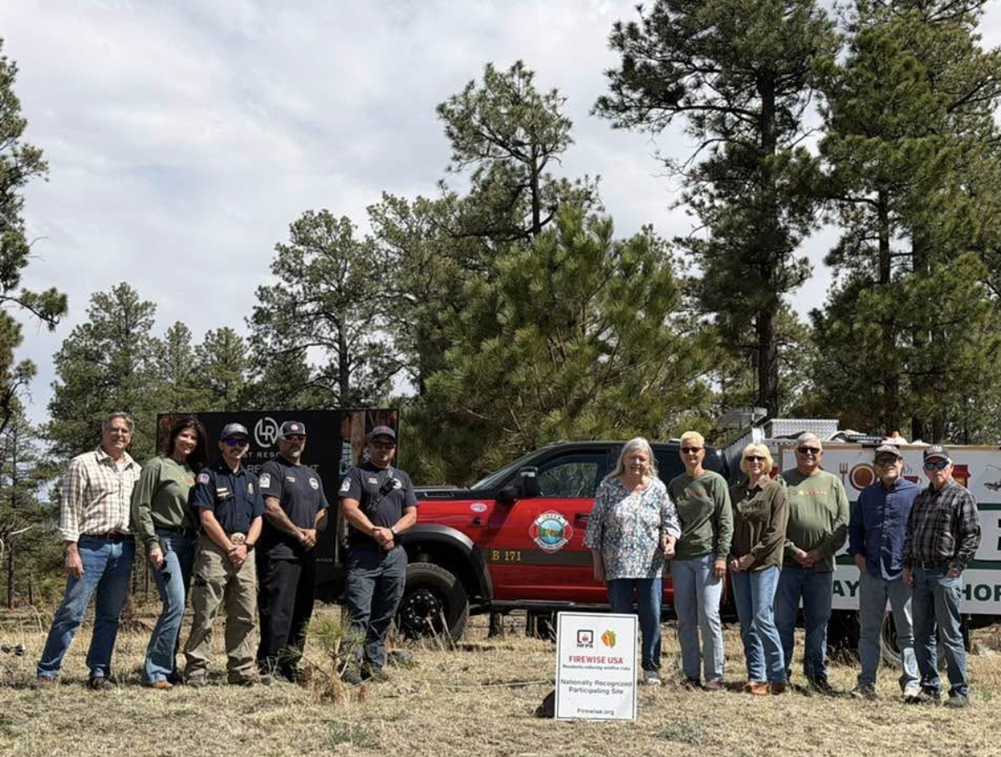
Greer FireWise Certification

Slide 32
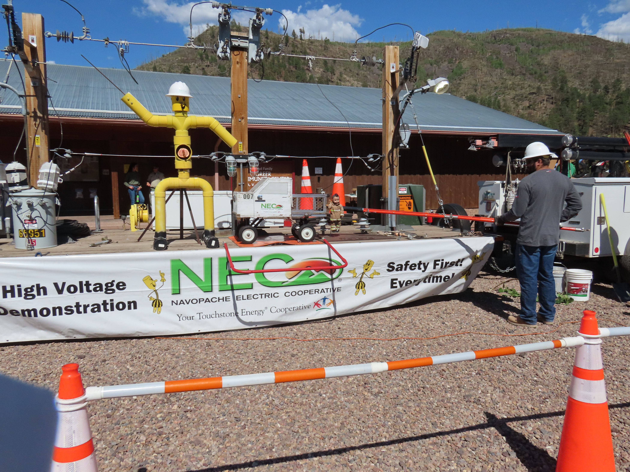
FireWise Community Meeting
June 2026

Slide 33
Greer Fire Prevention and Mitigation Working Group Agenda
FireWise compliance 2026:
  $125,000 in FireWise eligible expenditures
  1118 hours creating defensible spaces
  62 ½ tons of pine needles and desd fall removed
  Keep it Up!
  Continue doing work on your property
    Report all of your hours worked and expenses

Slide 34
Greer FireWise Portal
GreerWildfirePrep.com
  Website has the FireWise accounting link and
  Firewise information materials

Slide 35
Greer Fire Prevention and Mitigation Working Group Agenda
Electrical Grid and Fire Risk: NavapacheElectric (NE)
  Brian Brownlow, Operations Manager for NEC
  NEC Work in Greer
    Power line and easement inspection for fire risk. Began in March 2026
    Identified areas that require brush clearing and tree removal as well as areas of uninsulated power lines that need replacement.
    Work commenced in late Spring and Early Summer

Slide 36


Slide 37
Greer Fire Prevention and Mitigation Working Group Agenda
Forest Service Efforts:
  Forest Service Fire Mitigation Plan: Greer salvage timber sale, from all the mortality caused from the Greer fire. Likely timeframe is the wood will be sold this coming fall. Greer salvage timber sale primarily consists of the standing dead timber around Greer Lakes, and Benny Creek Campground.
  FireWise work on Forest Service land adjacent to private property:
    Tree permits available; remove tree completely and cannot sell wood; Prefer dry times of year (Spring); Contact Trace Douglas 928-292-6703
  Greer Perimeter ‘Treatment’:
    longer term plan to ‘treat’ the west and southwest flanks of Greer that the Arizona State Forestry and FireWise inspection identified as a particular wild fire threat to the community.
      NEPA from 20 yrs ago to treat 60-120ft from property lines. Estimate a NEPA renewal to take up to 5 years.
      Needs further study of the ‘wild land urban interface’ NEPA profile of the area between deeded Greer property and North Woods Rd.
      Matt Moe is our FS contact to continue to evaluate a global plan to ‘treat’ this area.

Slide 38
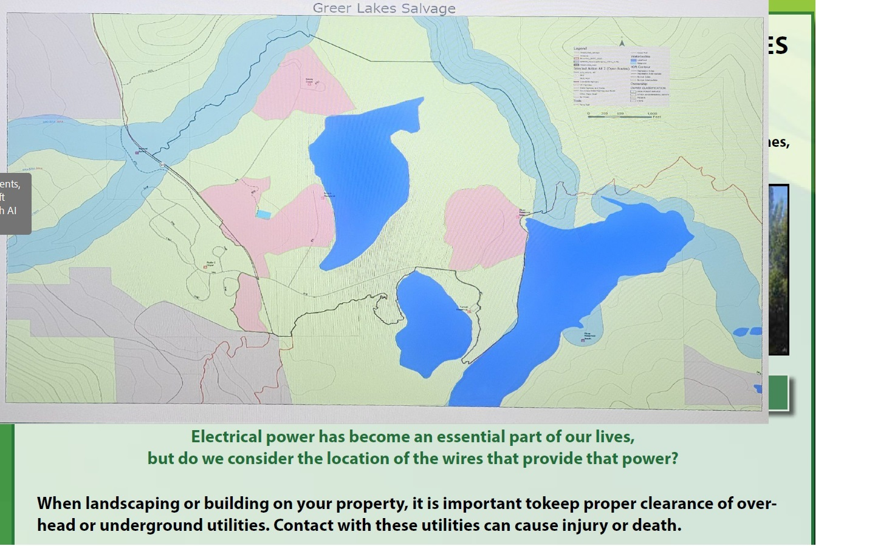

Slide 39
Greer Fire Prevention and Mitigation Working Group Agenda
Explore grants to fund fire mitigation on Greer private land. Greer Fire District
  Healthy Forest Initiative (HFI) State Grant Program:
    The Fire District consultant completed application for this grant: Unsuccessful in 2026
      Re-Application planned for 2027

Slide 40
Greer Fire Prevention and Mitigation Working Group Agenda
Explore and implement actions that help our Fire District improve firefighting capabilities:
  Water caches
  Hydrants

Slide 41
Greer Fire Prevention and Mitigation Working Group Agenda
How about Insurance?
Reports since April:
  Insurance cancellation involving a commercial owner reversed by consideration of our FireWise status. Insurer was Auto-Owners.
  Insurance Rate Decrease

Slide 42
What Can you do To Help GCI’s Efforts?
Given Recent History, It is more important than ever that you SUPPORT the Coalition.
MAKE A DONATION
Volunteer your time and resources
Participate in Community Activities
Members are the STRENGTH of the organization.
Numbers are the key to success.
Encourage Friends and Neighbors to join the GCI
Notes:
What can you do to get involved?

Slide 43
What Can you do To Help Our Efforts?
Support GCI with additional financial support
Join our effort TODAY by mail or through our website www.greercoalition.org!
Checks should be made to:
Greer Coalition Inc.
PO Box 265; Greer, Arizona 85927
Notes:
Your tax deductible contribution is vital to sustain GCI activities. The vast majority of GCI work is performed by our dedicated volunteers who have provided countless hours of work on behalf of the Greer Community. Monies are used by our board to pay postage, legal fees, insurance premiums and website maintenance.

Slide 44
Thank you for being involved in our Community
Thank you for being a member of the
Greer Coalition
Join us for light refreshments

Slide 45
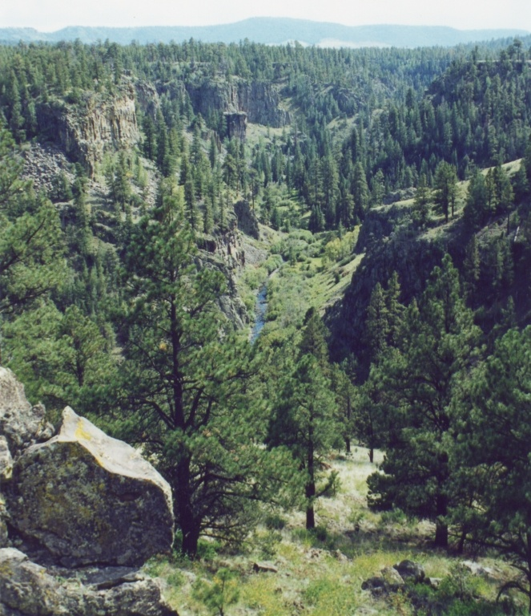
Greer Coalition
Annual Membership Meeting – 2026
A Sustainable Vision for Greer
Notes:
Good Morning! My name is Dave Bennett, I am a current board member of the Greer Coalition.
Today is our 2022 Annual Membership Meeting.
Our hope today is to share what the Board has been doing this pat year to represent you and your membership dollars and your donation's
We hope to draw from you, your thoughts and ideas for developing a “Sustainable Vision” for Greer
What thoughts come to your mind when we think of: A “Sustainable Vision for Greer?
I would like for a few of you out there share with the us why you have chosen Greer as an important part of your family life and what it means to you and what you believe it give in the way of values for your family.

Slide 46
The End

Slide 47
Homeowner Insurance
Ty Schraufnagel Insurance Agency: 480-888-1428; Broker for American Family Insurance; American Family is underwriting in Greer.
Insurers we know have written policies in the past year:
  State Farm: underwriting in Greer
  Progressive Insurance
  Co. Chubb Insurance; online search has suggested that Chubb prefers insuring homes with values greater than $1 million but we are aware of success in insuring homes in Greer of less value.
This is an evolving issue and we hope members of our community will let us know of other insurers that are willing to underwrite in Greer, and any of those we have identified who may change their practice and stop insuring in Greer.

